Slide 1

Category Code: C3
Problem Statement Title:Creating an all-in-one platform for startups, simplifying financial planning for new enterprises, and seamlessly connecting investors with SMBs
Team Name: Job Blowers
Institute Name: Vivekanand Education Society’s Institute of Technology

Slide 2








Idea / Approach details
Problem Statement
Our proposed Solution
Finsight AI
Your New Financial
Co-Founder
FinsightAI is an AI-powered platform that simplifies financial planning for startups and connects them with the right investors.
It provides data-driven loan recommendations, cash flow management, stock optimization, and credit risk analysis, ensuring startups make informed financial decisions.
With AI-driven investor matchmaking, real-time market insights, and automated financial planning tools, startups can optimize growth while investors gain access to transparent, high-potential opportunities.
By leveraging predictive analytics, smart recommendations, and real-time alerts, FinsightAI enhances financial stability, investment success, and business growth in a rapidly evolving market.
Overwhelmed by fluctuating revenue and unclear loan terms, Rohan is unsure how to secure funding.
Frustrated by a lack of financial transparency, Nirmala struggles to find promising startups.
Rohan uses the platform to receive personalized loan suggestions, cash flow strategies, and investor matches.
Nirmala accesses AI-driven financial reports, helping her discover trustworthy startups to invest in.
Rohan secures funding, Nirmala makes a profitable investment, and the platform bridges the funding gap.
Notes:
1.7.2013
‹#›

Slide 3

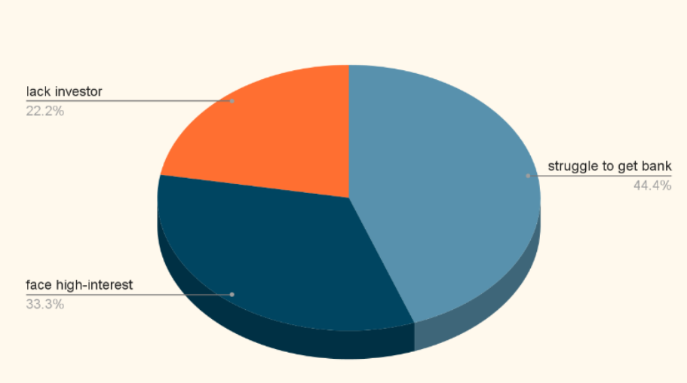
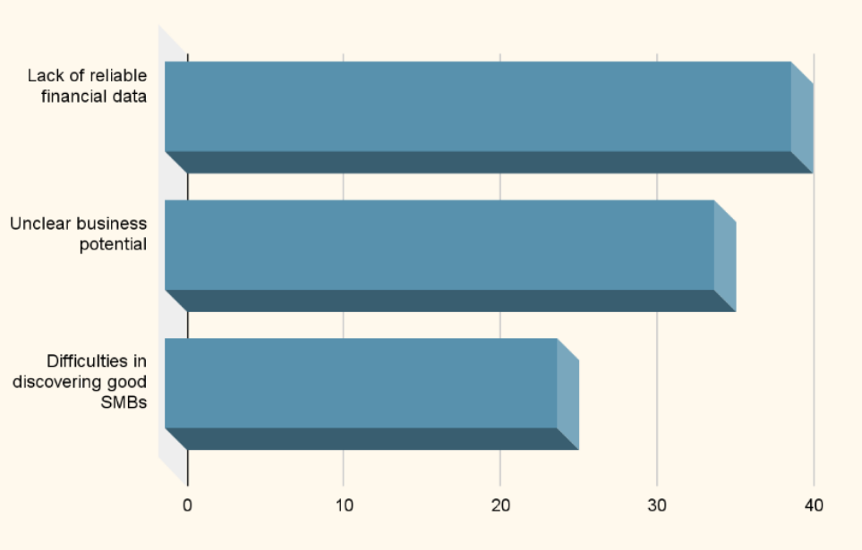
WHATS THE NEED OF OUR PLATFORM??
Struggles Start up face related to financial health
Struggles Investors Face
Source Link

Slide 4
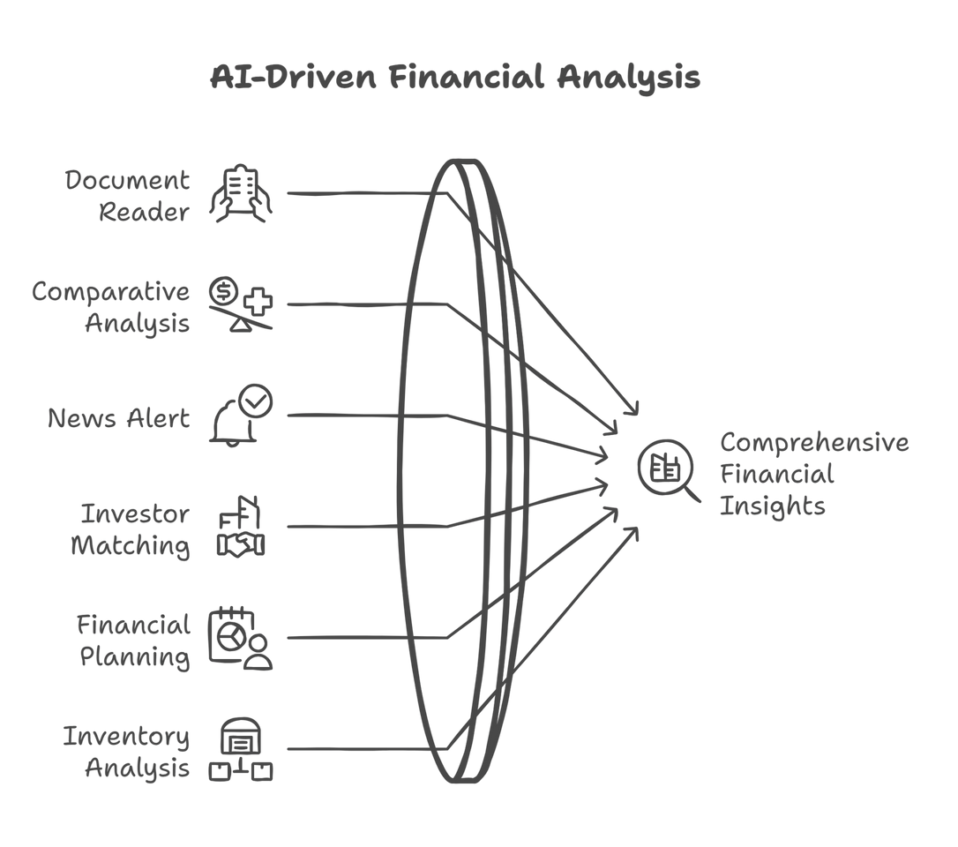
Innovation
Loan & Credit Optimization
Unlike traditional lending platforms (e.g., Kabbage), Finsight AI analyzes financial history and provides personalized loan recommendations based on AI models
Intelligent Cash Flow & Investment Management
Uses AI to predict cash surplus/deficits and suggest investment or cost-cutting measures.
Smart Stock & Inventory Optimization
Real-time stock tracking with AI-based demand forecasting to suggest optimal inventory refilling.
Analyzes supplier pricing trends to help businesses optimize costs.
Agent Backed Investor Matching
Finsight AI matches startups to investors dynamically based on historical investment patterns and startup financial health.
Personalized investment insights for investors to reduce risks.
AI-Powered News & Market Intelligence
Keeps startups updated on market trends and competitor moves in real time.
AI-curated news alerts help businesses make data-driven decisions.
AI AGENT DIAGRAM
Notes:
1.7.2013
‹#›

Slide 5



Tech Stack
Connects startups and investors
Ai-driven insights for better decision-making
Helps startups plan effectively
Meeting the rising demand for funding solutions.
Partnerships with banks and other financial institutions.
S
O
SWOT
W
Earning credibility among users.
Compliance with financial laws
Highly accurate data needed for reliability.
Competition from other fintech apps.
Risk of data breaches.
T
Notes:
1.7.2013
‹#›

Slide 6

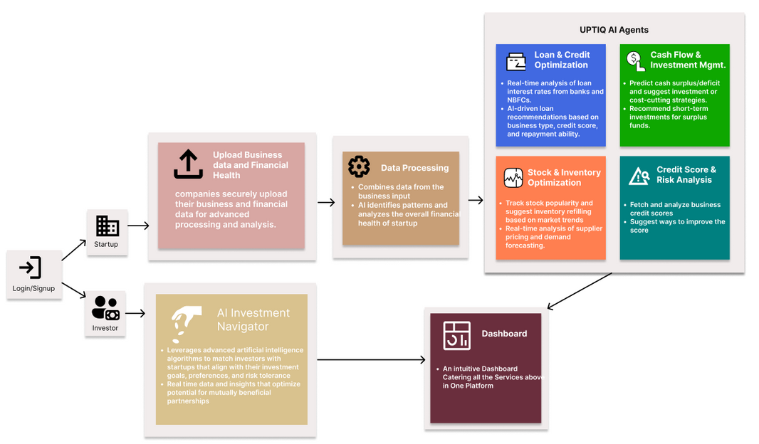
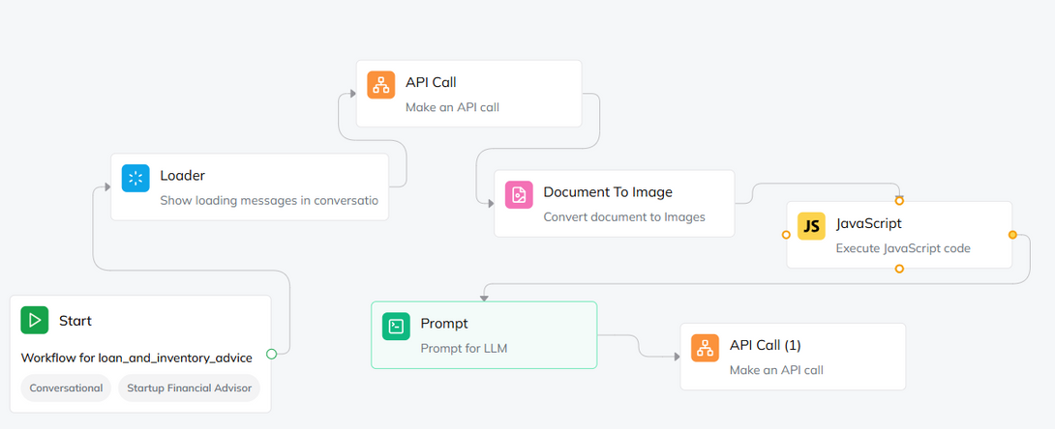
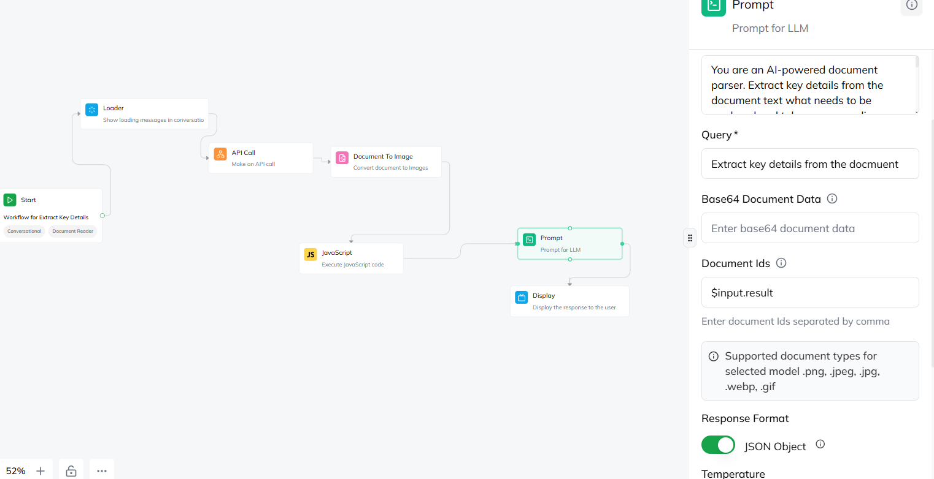

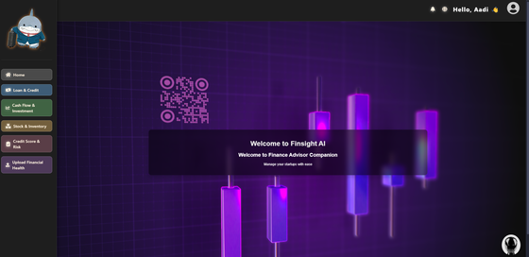
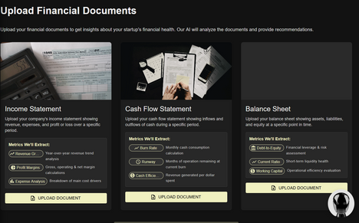
Implementation/Prototype/Use Case Diagram (screenshots)
FLOWCHART
INTENTS WORKFLOW
Workflow for Stocks and Investor Advisor, the subagent fetches data from backend, processes it and sends advisory data back to the backend so that React can fetch and display the data.
PROJECT SCREENSHOTS
Workflow for Document Upload, the subagents take 3 documents, Income Statement, Cash Flow Statement and Balance Sheet
Notes:
1.7.2013
‹#›

Slide 7
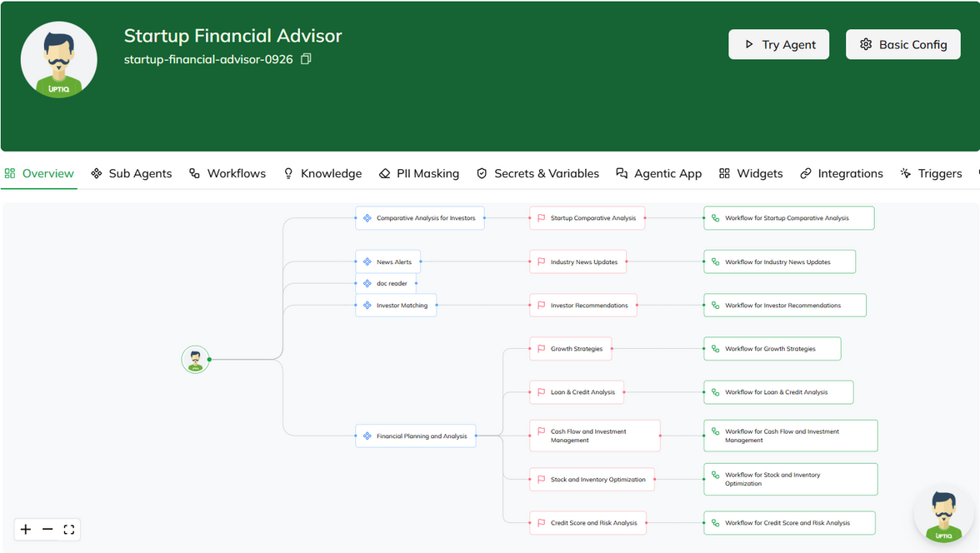
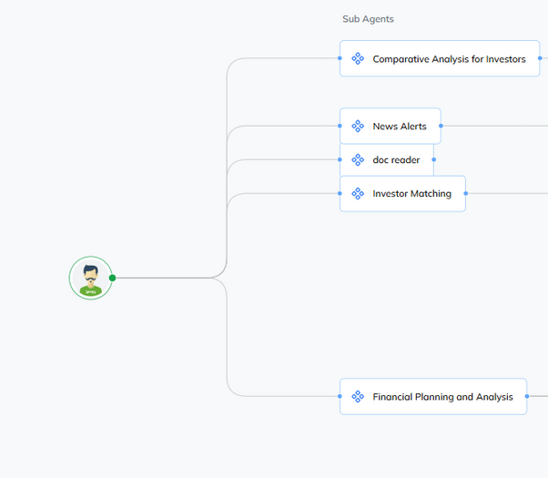
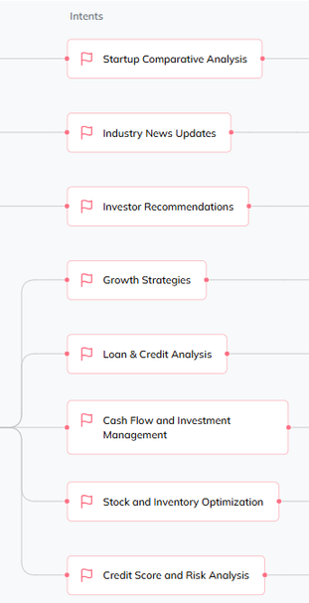
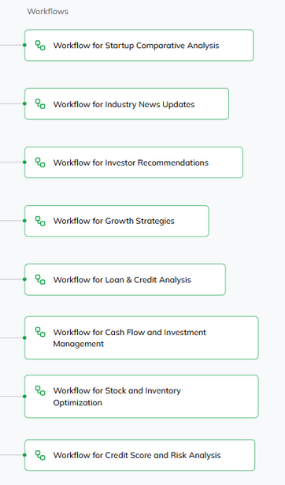
Uptiq Agents
FINANCIAL ADVISOR AGENT
Subagents:
Comparative Analysis for Investors
Output - Analyzes and compares different startups based on key financial metrics.
Parameters used : Revenue, Gross Profit, Operating Profit, Net Income
Industry News Updates
Output - Provides updates on industry trends and competitor activities to help startups stay informed.
Parameters used: Competitor Financial Moves,Market Trends,Regulatory Alerts
Investor Matching
Output - Suggests potential investors who are genuinely interested in startups, based on their investment history and habits.
Parameters used: Startup financial profile + Investor preferences
Financial Planning and Analysis
Growth Strategies -
Loan & Credit Analysis -
Cash Flow and Investment Management -
Stock and Inventory Optimization -
Credit Score and Risk Analysis -
The Agent is modularized into 6 Sub-Agents, each with their own feature. There are a total of 14 intents
AGENTS ANALYSES THESE METRICS BY THESE FOLLOWING DOCUMENTS
1) INCOME STATEMENT
2) CASH FLOW STATEMENT
3) BALANCE SHEET
4) MARKET DATA THROUGH HISTORICAL DATASET
Notes:
1.7.2013
‹#›

Slide 8
Sub-Agent 1 :Document Reader
Aim of Sub-Agent: To Read the Documents And Extract important Financial Terms from it
There are actually 3 sub agents derived from this:
Income Statement Reader
Cash Flow Statement Reader
Balance Sheet Reader
Input- Income Statement of the company
Metrics Extracted -
Total Revenue
Gross Profit Margin
Operating Profit (EBIT)
Net Profit Margin
Earnings Per Share (EPS)
Input- Cash Flow Statement of the company
Metrics Extracted -
Total Revenue
Gross Profit Margin
Operating Profit (EBIT)
Net Profit Margin
Earnings Per Share (EPS)
Input- Balance Sheet of the company
Metrics Extracted -
Total Revenue
Gross Profit Margin
Operating Profit (EBIT)
Net Profit Margin
Earnings Per Share (EPS)

Slide 9
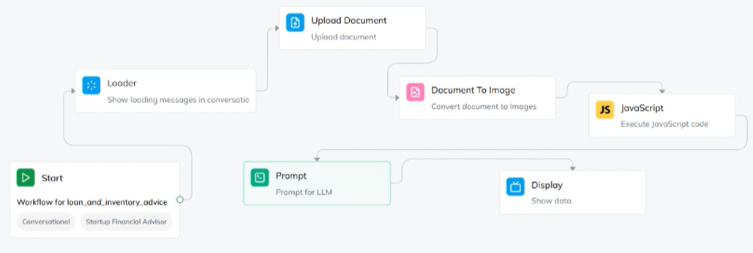
Sub-Agent 2 :Inventory and Stock Analysis
Aim of Sub-Agent: Tracks stock popularity and suggests inventory refilling based on market trends
Workflow
It analyzes the Metrics and gives suggestions on stock / inventory refilling based on market trends

Slide 10
Sub-Agent 3 :Financial Planning and Analysis
Aim of Sub-Agent: To give Financial Planning and Analysis
INTENTS
Growth Stratergies
Provides recommendations based on widely implemented business strategies and guides startups in budgeting and resource management using AI-based tools.
Loan & Credit Analysis
Offers AI-driven loan recommendations, and gives suggestions on how to optimize their financial health
Cash Flow & Investment management
Predicts cash surplus or deficit and suggests investment or cost-cutting strategies, including recommendations for short-term investments like FDs, bonds, and mutual funds.
Credit Score and Risk Analysis
Fetches and analyzes business credit scores and optimizes them.

Slide 11
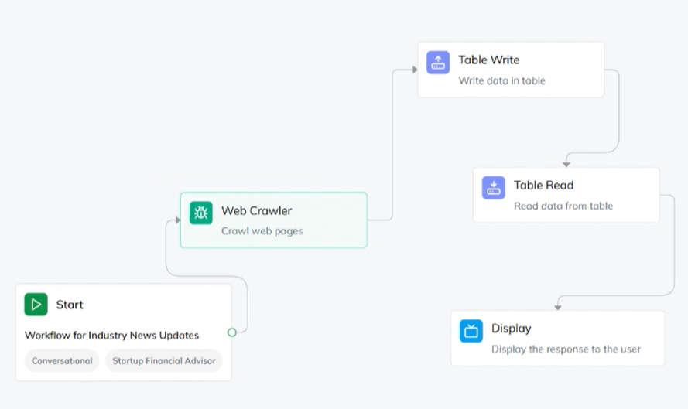
Sub-Agent 4 :News Alert
Aim of Sub-Agent: To Give News Alerts of Competetive Rivals of a Buisness
Workflow
It WebScrapes The Websites by WebCrawler Node and gives every news relevant to the startups domain and industry

Slide 12
Future Objectives
Blockchain powered funding and compliance
Seamless Workflow Integration
Give Real-Time Investor Insights
Pitch Deck
Investors and startups can communicate, schedule meetings, track progress,and share documents effortlessly
Crunchbase and Traxcn API’s being Exclusive users only
Smart contracts for secure, automated, and transparent funding.
Pitch Deck that provides insights into presentations and financial overciews for investors

Slide 13
Cash Flow Management Issues
60% of Small Businesses Struggle With Cash Flow Management: This article highlights the prevalence of cash flow challenges among small businesses and the risks associated with ineffective management.
FinTechs to the Rescue
Facing manual processing constraints, many SMBs are turning to financial technology (FinTech) solutions. Despite a forecasted 50% surge in payment volumes and a 46% rise in invoicing over the next three years, many SMBs remain saddled with outdated systems.
1. Poor Inventory Management
The Costly Consequences of Poor Inventory Management: This article discusses how inadequate inventory control can lead to stockouts, production delays, and lost sales, ultimately harming a company's reputation and financial health. ​LinkedIn
Catastrophic Inventory Mistakes by Huge Brands and How to Avoid Them: This piece highlights real-life examples of poor inventory management and its detrimental effects on businesses. ​Asset Panda
Lack of Strategic Planning for Growth
The Five Stages of Small-Business Growth: This Harvard Business Review article categorizes the problems and growth patterns of small businesses, emphasizing the importance of strategic planning at different stages. ​Harvard Business Review
Small Business Growth: Common Problems and Solutions: This article outlines common growth challenges faced by small businesses and offers strategies to overcome them. ​theaustralian. LinkedIn

Slide 14
Automation on Financial Document Analysis
Analyzing financial documents such as income statements, balance sheets, and cash flow statements manually can be labor-intensive and prone to errors. Transitioning to automated systems offers several advantages that enhance the efficiency and accuracy of financial analysis:
1. Increased Productivity
Automation accelerates the processing of financial data, enabling faster completion of tasks and allowing staff to focus on strategic activities. For instance, integrating Optical Character Recognition (OCR) within accounts payable workflows can streamline data extraction and processing.
2. Improved Accuracy and Reduced Errors
Manual data entry is susceptible to mistakes. Automated systems standardize data input and calculations, minimizing errors and ensuring consistent and reliable financial reports.
3. Cost Management
By reducing the need for extensive manual labor, automation lowers operational costs. It optimizes resource allocation, leading to increased profitability.
5. Scalability and Flexibility
As businesses grow, automated financial systems can easily scale to handle increased data volumes and complex reporting requirements without a proportional increase in manual effort.
6. Faster Reporting and Decision-Making
Automation enables real-time data processing and report generation, providing stakeholders with timely financial information to support swift decision-making.
Research Link

